Slide 1
Deep learning basics part 1

Slide 2
Introduction
Recommended reading:
http://www.deeplearningbook.org/

Slide 3
Introduction
What is Deep Learning?
How does it differ from Machine Learning?
What are its applications?
What algorithms are being used?

Slide 4
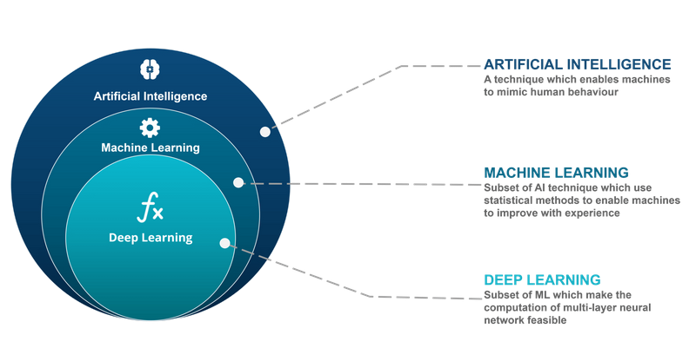
Wprowadzenie

Slide 5
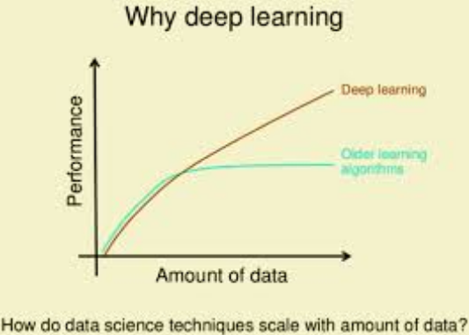
Wprowadzenie

Slide 6
Introduction
Applications:
https://www.youtube.com/watch?v=miPyFmr4iCc
https://www.youtube.com/watch?v=0yI2wJ6F8r0
https://www.youtube.com/watch?v=iutOIJt1zVM
https://www.youtube.com/watch?v=fa5QGremQf8
https://www.youtube.com/watch?v=ohmajJTcpNk

Slide 7
Introduction
Perceptron (Rosenblatt 1957):
𝑥₁
𝜃
1
𝑥₂
𝜃₂
∑
𝑥_{1𝑥}
𝑦
⋮
𝜃_{𝑛}
𝜃₀
1_{𝑥1}
𝑥_{𝑛}
1
𝑦 = f(𝑥⊤𝜃)

Slide 8
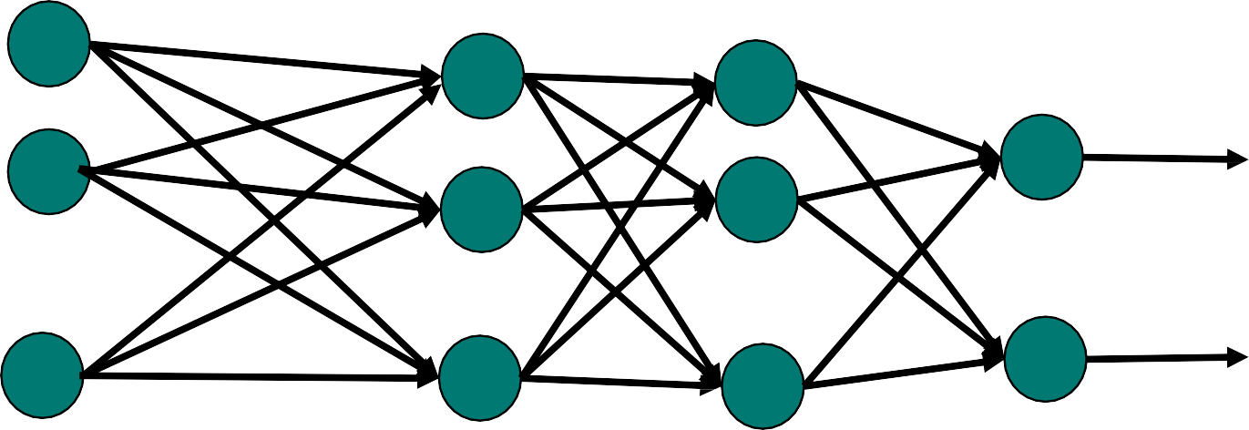
Introduction
Nets with hidden layers are much more interesting for AI than simple perceptrons
𝑥₁
₁
𝑥₂
𝑦₁
⋮
⋮
⋮
⋮
𝑦_{𝑚}
𝑥_{𝑛}

Slide 9
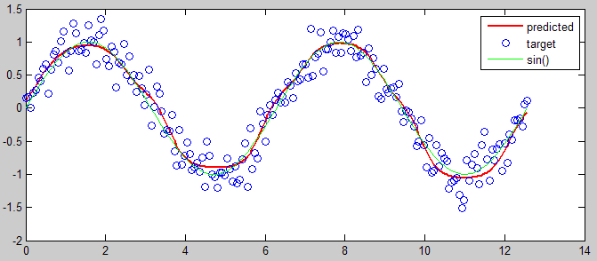
Introduction
The problem of learning a ANN model is just a problem of approximating some function φ(x) by a composition of functions: φ’(x) = f^{(L)}(... f⁽²⁾(f⁽¹⁾(x, θ⁽¹⁾), θ⁽²⁾), …,)θ^{(L)}), where f^{(i)} is the activation function in the i-th layer and θ^{(i)} is the weight matrix on the i-th layer.
Źródło: https://stackoverflow.com/questions/1565115/approximating-function-with-neural-network

Slide 10
Activation functions
Another important element of ANN architecture that need to be defined before training the model (such parameters are called hyperparameters) are activation functions 𝑓^{(𝑖)} for each layer of the model.
Choice that kind of layer to choose depends on many factors: the purpose of the model (output), optimization algorithm, etc..

Slide 11
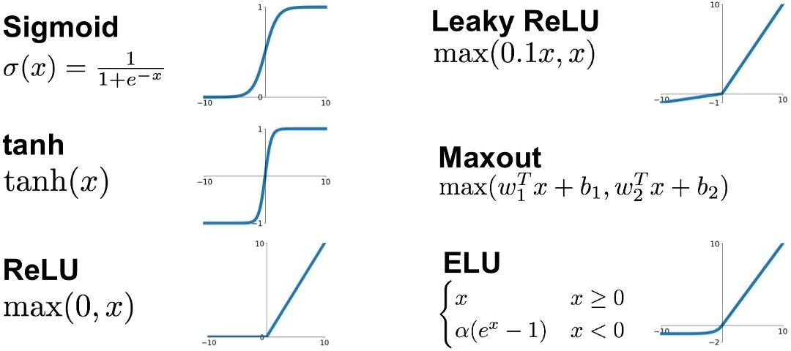
Activation functions
The most popular activation functions are presented below:
Source: https://medium.com/@shrutijadon10104776/survey-on-activation-functions-for-deep- learning-9689331ba092

Slide 12
Neural Net Learning
Learning is the most important step while training a DL model – this heavily affects the estimation performance.
Learning is an optimization process – we seek such values of weights 𝜽, which minimizes the const function 𝑱(𝜽).
The most commonly used algorithm for that is the backpropagation algorithm.

Slide 13
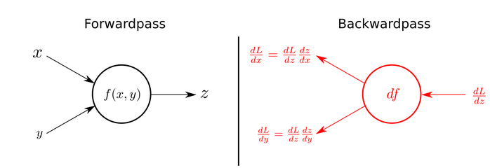
Neural Net Learning

Slide 14
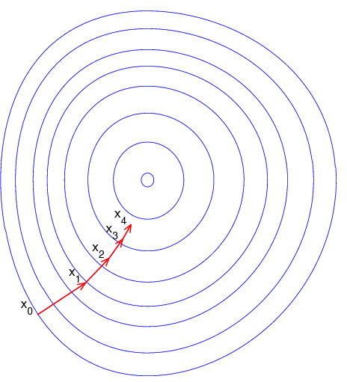
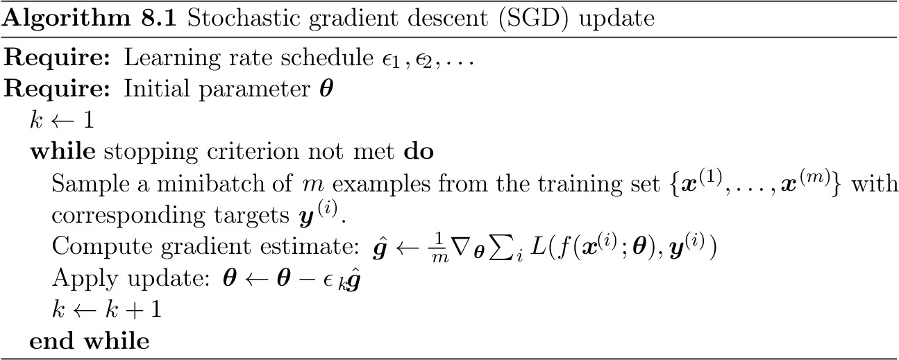
Neural Net Learning
Most commonly used optimization algorithm for Neural Net Learning are algorithms from the family of stochastic gradient algorithms.

Slide 15
Neural Net Learning
E.g.:
SGD
SGD with momentum (Polyak, 1964)
SGD with Nesterov momentum (Nesterov, 1983, 2004)
AdaGrad (Adaptive Gradient Algorithm) (Duchi et. al. 2011)
ADAM (Adaptive Moment Estimation) (Kingma & Ba, 2015)

Slide 16
Neural Net Learning
When using those algorithms, crucial is to choose an appropriate value of learning rate 𝝐
Usually it is not set to a constant value for all iterations of the training, but it is prone to change during training.

Slide 17

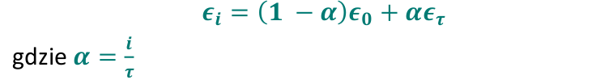
Neural Net Learning
When using those algorithms, crucial is to choose an appropriate value of learning rate 𝝐
Usually the learning rate is decreasing linearly to some iteration τ and then it is stable:

Slide 18
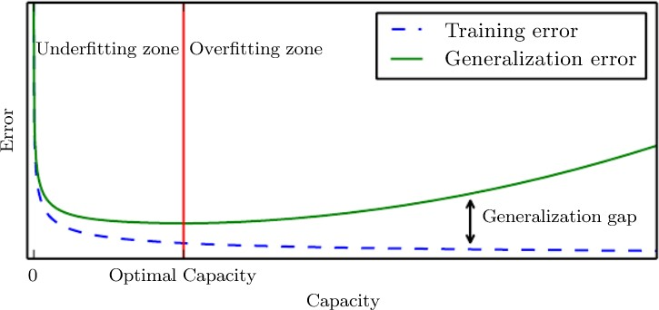
Regularization
The goal of regularization is to prepare an algorithm, that will work well not only on training data, but also on the test data.
The aim of regularization is to minimize the generalization error:

Slide 19
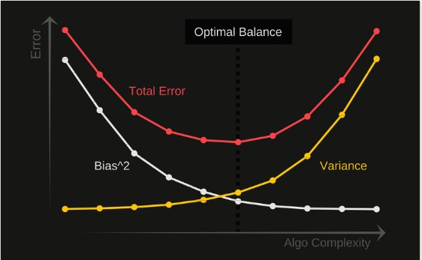
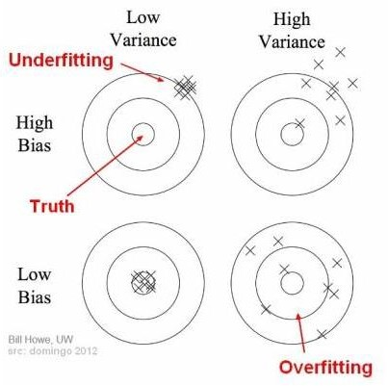
Bias-Variance Tradeoff
Source: https://towardsdatascience.com/understanding-the-bias-variance-tradeoff-165e6942b229

Slide 20
Regularization
One of the most popular regularization techniques is giving penalties dependent on model parameters:
Most commonly used are:
L2 regularization (also known as Tichonow regularization)
L1 regularization

Slide 21
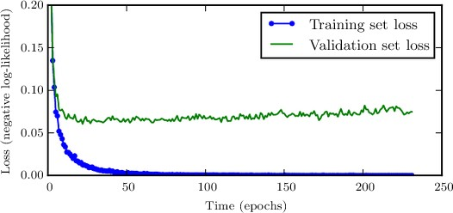
Regularization
Another regularization technique is early stopping.
This method relies on the following observation – the error on the training dataset gets lower in every next iteration, but the error on the validation/test dataset decreases to some point, and then starts to increase.

Slide 22
Regularization
The idea is to train the model long enough (up to the moment, then the error on the test dataset starts to increase) and from the all generated models choose the one, that had the lowest error on the test dataset.

Slide 23
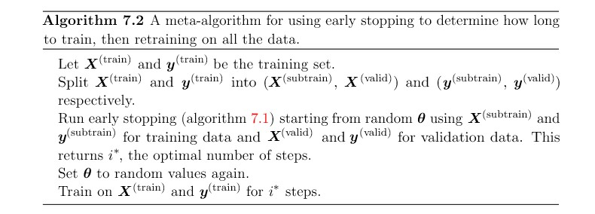
Regularization
Early stopping is an intuitive algorithm.
3 things are problematic with it:
Choosing the appropriate number of steps.
Running the model on the validation set multiple times.
Storing all intermetiate trained models.

Slide 24
Regularization
Other regularization techniques:
Bagging (bootstrap aggregating): It relies on sampling with repetition k observations from the input data set and estimating k models on them, and then averaging their results.
Dropout: Works in a similar way to bagging - the difference is that instead of sampling the input data, neurons are removed from the model.

Slide 25
Choosing model hyperparameters
Hyperparameters are parameters, which value is set before starting the ANN training process (e.g. number of layers, number of neurons in a layer, learning rate, ...).
Wrong values of those parameters can lead to over- or underfitting the model.

Slide 26
Choosing model hyperparameters
Choosing the right hyperparameters’ values can be done:
Manually (just choosing some values, training, choosing other values, training, ...)
Using an appropriate algorithm that takes values from the hyperparameters’ domains
Treating it as an optimization problem.

Slide 27
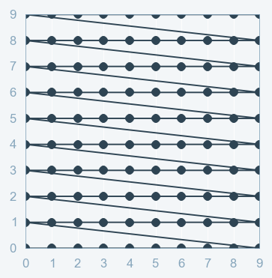
Choosing model hyperparameters
Grid

Slide 28
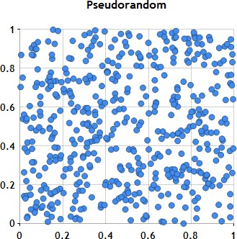
Choosing model hyperparameters
Random

Slide 29
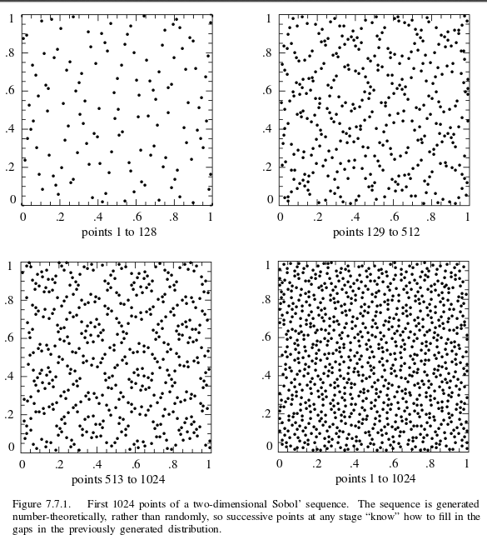
Choosing model hyperparameters
Sobol sequences

Slide 30
Demo (MNIST & Fashion MNIST)

Slide 31
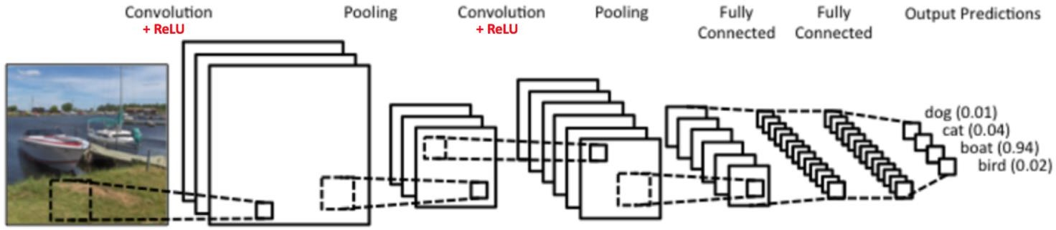
Convolutional Neural Network
Source: https://ujjwalkarn.me/2016/08/11/intuitive-explanation-convnets/

Slide 32
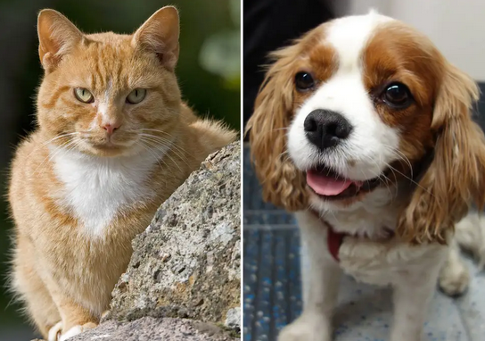
Convolutional Neural Network
Demo

Slide 33
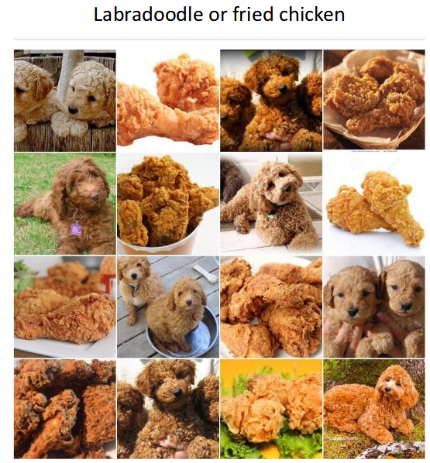
Convolutional Neural Network
Demo

Slide 34
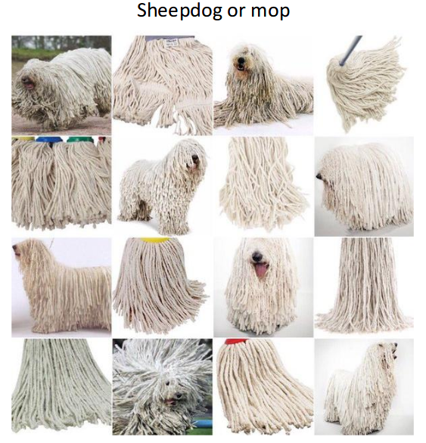
Convolutional Neural Network
Demo

Slide 35
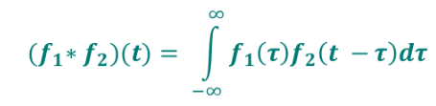
Introduction
Intuitively convolution can be seen as weighting one function with another one.
Convolution of two functions is defined as:

Slide 36
Convolution features
Convolution is:
Commutative:
𝑓₁ ∗ 𝑓₂ = 𝑓₂ ∗ 𝑓₁
Associative:
(?₁∗ 𝑓₂) ∗ 𝑓₃ = 𝑓₁ ∗ (?₂∗ 𝑓₃)
Multiplication is distributive with respect to addition:
(𝑓₁ + 𝑓₂) ∗ 𝑓₃ = 𝑓₁ ∗ 𝑓₃ + 𝑓₂ ∗ 𝑓₃

Slide 37
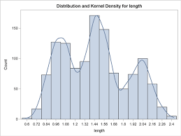
Applications
Probability theory and statistics:
Calculating the moving average.
Sum of two independent random variables is a convolution of their distributions
Kernel density estimator.

Slide 38
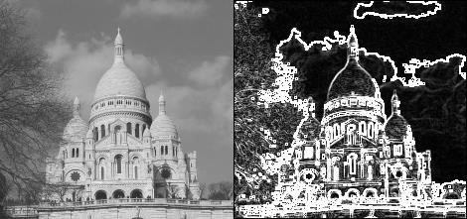
Applications
Image processing:
Detecting edges.

Slide 39
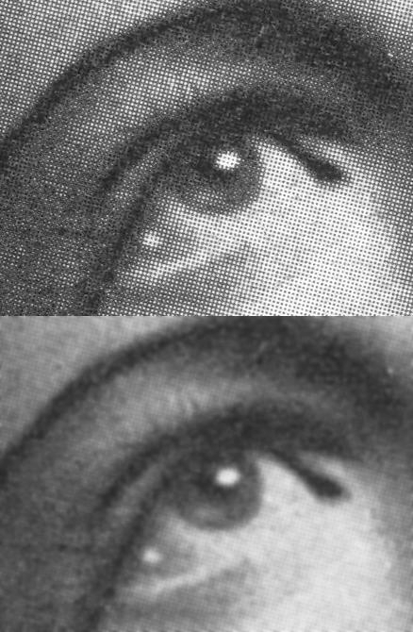
Applications
Image processing:
Detecting edges.
Image smoothing.

Slide 40
Applications
For image (or tabular) data) convolution operation can be treated as an operation on matrices:
1 | 1 | 1 | 0 | 0
0 | 1 | 1 | 1 | 0
0 | 0 | 1 | 1 | 1
0 | 0 | 1 | 1 | 0
0 | 1 | 1 | 0 | 0
1 | 0 | 1
0 | 1 | 1
1 | 0 | 1
Input
Kernel
Output

Slide 41
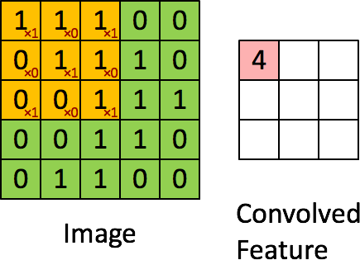
Applications
In an image case (or tabular data) convolution operation can be treated as an operation on matrices:
https://ujwlkarn.files.wordpress.com/2016/07/convolution_schematic.gif?w=268&h=196&zoom=2

Slide 42
Applications
After applying a convolution between an input image and a filter we loose some information from the input image.
1 | 1 | 1 | 0 | 0
0 | 1 | 1 | 1 | 0
0 | 0 | 1 | 1 | 1
0 | 0 | 1 | 1 | 0
0 | 1 | 1 | 0 | 0
1 | 0 | 1
0 | 1 | 1
1 | 0 | 1
Input
Kernel
Output

Slide 43
Applications
It may be a problem especially when convolution operation is repeated many times (as in CNN).
1 | 1 | 1 | 0 | 0
0 | 1 | 1 | 1 | 0
0 | 0 | 1 | 1 | 1
0 | 0 | 1 | 1 | 0
0 | 1 | 1 | 0 | 0
1 | 0 | 1
0 | 1 | 1
1 | 0 | 1
Input
Kernel
Output

Slide 44
Applications
In such case it is good to consider zero – padding:
0 | 0 | 0 | 0 | 0 | 0 | 0
0 | 1 | 1 | 1 | 0 | 0 | 0
0 | 0 | 1 | 1 | 1 | 0 | 0
0 | 0 | 0 | 1 | 1 | 1 | 0
0 | 0 | 0 | 1 | 1 | 0 | 0
0 | 0 | 1 | 1 | 0 | 0 | 0
0 | 0 | 0 | 0 | 0 | 0 | 0
1 | 0 | 1
0 | 1 | 1
1 | 0 | 1
Input
Kernel
Output

Slide 45
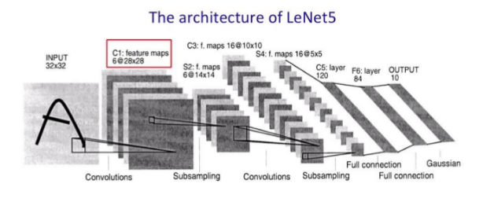
Convolutional Neural Network
Let’s begin with convolutional neural networks
As an example we will go through the model that classifies objects found on the images.

Slide 46
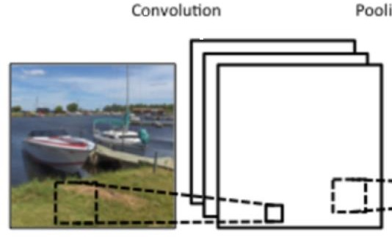
Convolutional Neural Network
Step 1:
Convolution

Slide 47
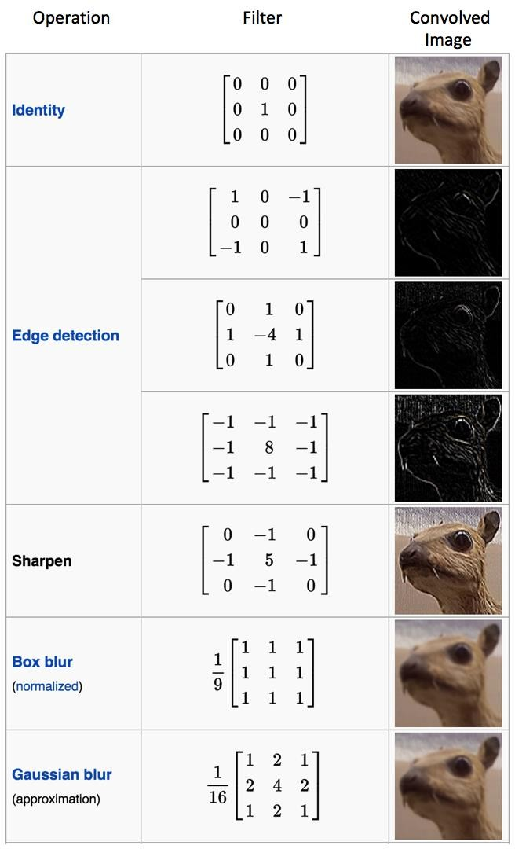
Convolutional Neural Network
As we know convolutions are the basis of most graphic filters.
Using different filters allows us to get different image characteristics.
Thanks to convolution we can create feature maps.

Slide 48
Convolutional Neural Network
Convolution as an ANN operation has many useful properties.
Feedforward Neural Networks can be used for problems involving work with imagesm but:
It would not be effective – we would need to treat every single pixel and as input and properly weight it.
Optionally we could in the beginning manually filter out and extract key image traits (computer vision techniques).
Moreover each image would need to be structured in the same way and the object would need to be placed in the same location on the image.
Convolutional neural networks solve those problems.

Slide 49
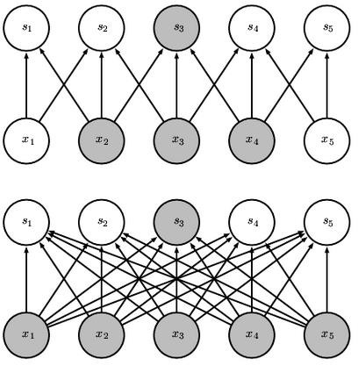
Convolutional Neural Network
First of all convolution neural networks use phenomenon called sparse interactions/sparse connectivity:
It exists, because the kernel
is usually much smaller that
the input matrix/data.
Thanks to that there are lesser
trainable parameters, less
memory is required and
the training is faster.

Slide 50
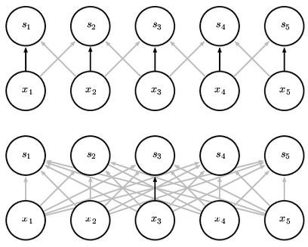
Convolutional Neural Network
Another important feature of convolutional neural networks is parameter sharing:

Slide 51
Convolutional Neural Network
Convolutional neural networks are equivariant to translation.
This means, that it can recognize shapes/objects/patterns regardless of its location on an image.

Slide 52
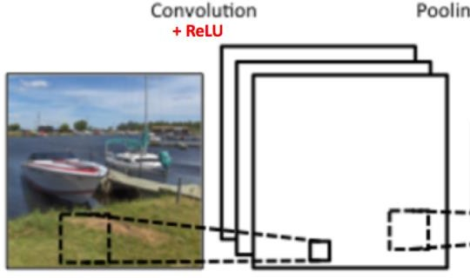
Convolutional Neural Network
Step 2:
Introducing nonlinearity (detector stage):

Slide 53
Convolutional neural networks
Convolution is a linear operation.
But in reality relations between objects are usually nonlinear.
ANN are used to get this nonlinear relationship between data.
This is why the results from the convolution step are then served as an input for a non-linear function (e.g. ReLu).

Slide 54
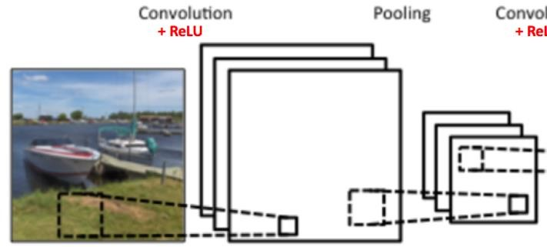
Convolutional neural networks
Step 3:
Pooling

Slide 55
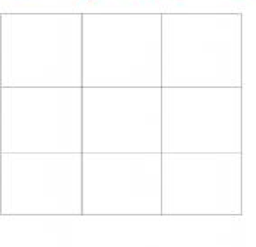

Convolutional neural networks
Pooling can be treated as a special functions, that in the same time maps and cropps available data.

Slide 56
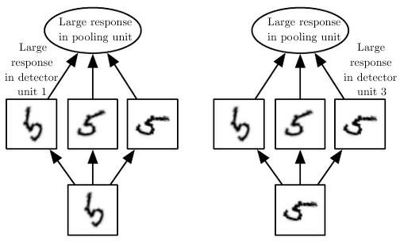
Convolutional neural networks
Pooling is an important step in DNN, because of its features such as:
The most important one is that approximation is
invariant to local translation.
Allows to compare images of different sizes
Smaller the number of parameters, lesser chance of overfitting and increased computational efficiency.

Slide 57

Convolutional Neural Networks
Procedure can be repeated many times, because we want to have a deep model
Usually the last layer is a MLP, which is used to translate the convolution results into probabilities

Slide 58
Demo (MNIST & Fashion MNIST)

